Slide 1
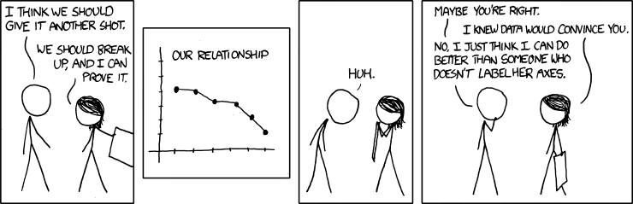
Univariate Regression
Geog4300/6300
Jerry Shannon

Slide 2
Variablesc | Tests; test statistics; SE
Continuous; one sample: σ known and n > 30 OR data is a proportion | One-sample z-test; Z; SE = σ/sqrt(n); OR Diff. of proportions
Continuous; one sample: σ unknown or n < 30 | One-sample t-test; t; SE = s/sqrt(n-1)
Continuous; two samples | Student’s t-test for difference of means
Continuous; paired samples | Paired t-test
Continuous; more than two samples | ANOVA
Discrete; two variables; counts | Chi-square, goodness of fit
Continuous; two or more variables | Correlation
Continuous; two or more variables | Regression
You are here

Slide 3
Simple (univariate) regression
Assesses the effect of one variable (x) on another (y)
Multivariate regression
Assesses the effect of several variables (x₁, x₂, x₃, etc.) on a single y

Slide 4
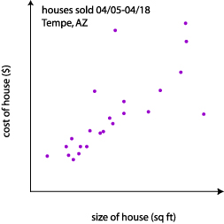
Correlation
tells us how strongly x and y are related
Regression
tells us how a change in x is associated with a change in y
Correlation:
There is a strong positive relationship (r=0.81) between the size of a house and its selling price.
Regression:
The price of a house goes up $10,000 for each additional 500 square feet.

Slide 5
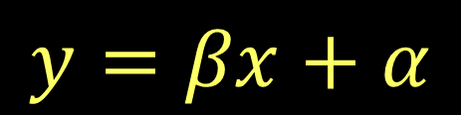

Regression creates a linear model, an equation based line that allows for prediction.
Another kind of model…

Slide 6
Assumptions of regression:
Independent observations
Dependent variable is normal and ratio/integer
Linear relationship between variables

Slide 7
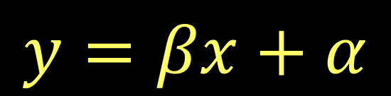
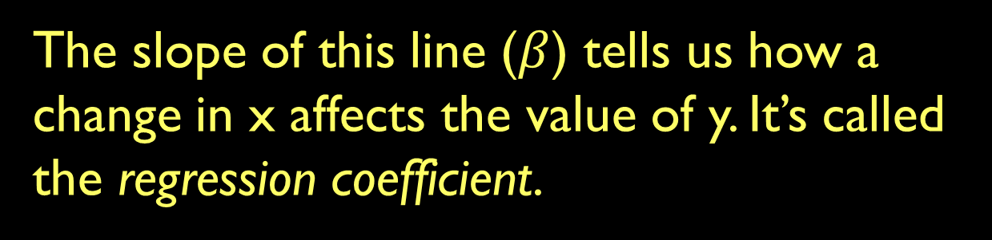

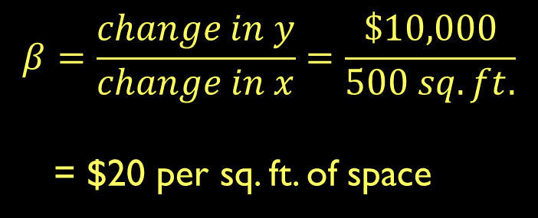
$10K
500 sq. ft

Slide 8
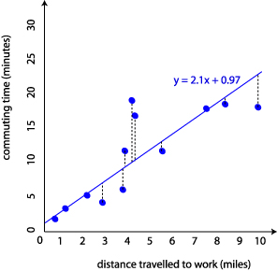

How is distance travelled to work associated with commuting time?
How would you interpret the equation?
$$y=2.1x+0.97$$

Slide 9
The “best fit” regression line:
Draw a line that minimizes the distances from points to the line
The dotted black lines are the residuals.
What might account for them?

Slide 10
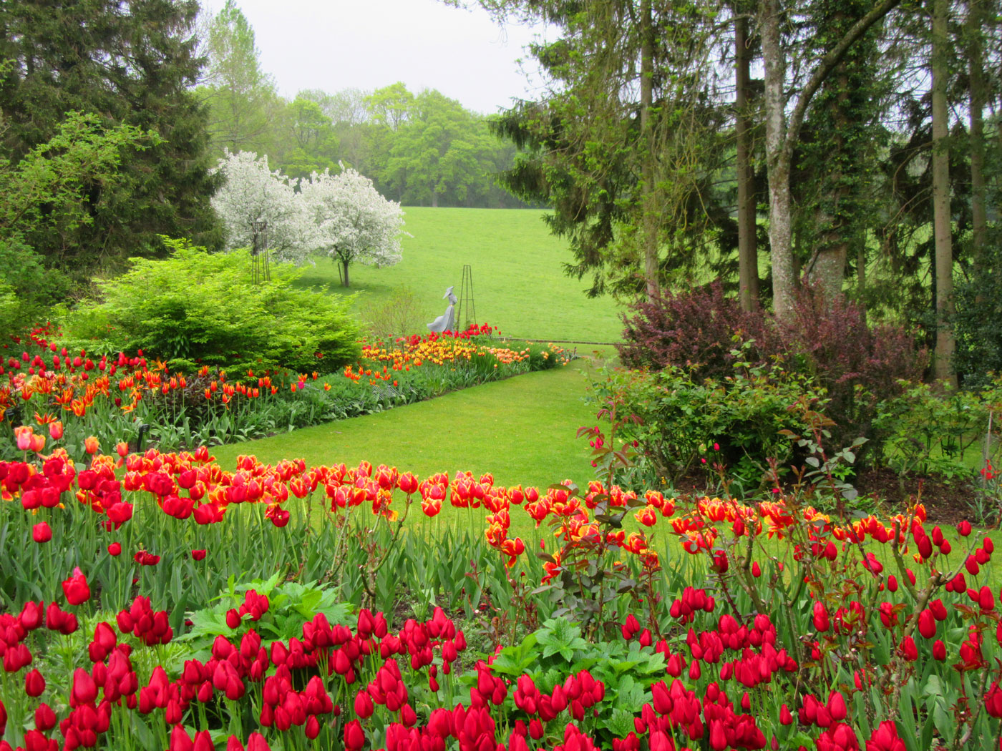
Example: How is median age related to number of gardens in six sample neighborhoos?
Neighborhood | Median age | Number of gardens
1 | 43 | 99
2 | 21 | 65
3 | 25 | 79
4 | 42 | 75
5 | 57 | 87
6 | 59 | 81

Slide 11
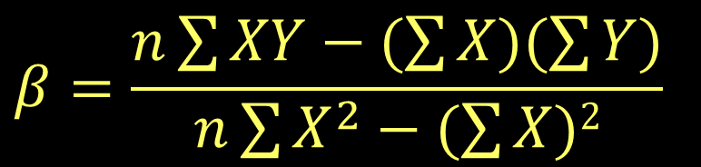
Calculating your regression line
(You almost always use software to do this, but…)
The sum of X and Y respectively
The sum of products of X and Y
Neighborhood | Median age | Number of gardens
1 | 43 | 99
2 | 21 | 65
3 | 25 | 79
4 | 42 | 75
5 | 57 | 87
6 | 59 | 81

Slide 12
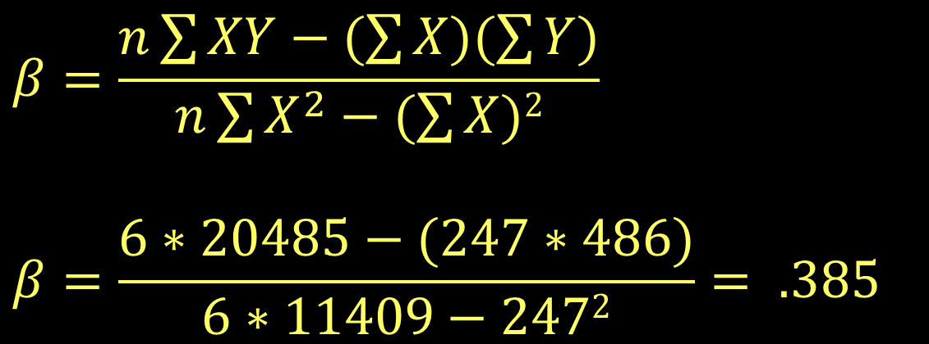
Calculating your regression line
Neighborhood | Median age | Number of gardens | X² | XY
1 | 43 | 99 | 1849 | 4257
2 | 21 | 65 | 441 | 1365
3 | 25 | 79 | 625 | 1975
4 | 42 | 75 | 1764 | 3150
5 | 57 | 87 | 3249 | 4959
6 | 59 | 81 | 3481 | 4779
Total | 247 | 486 | 11409 | 20485

Slide 13
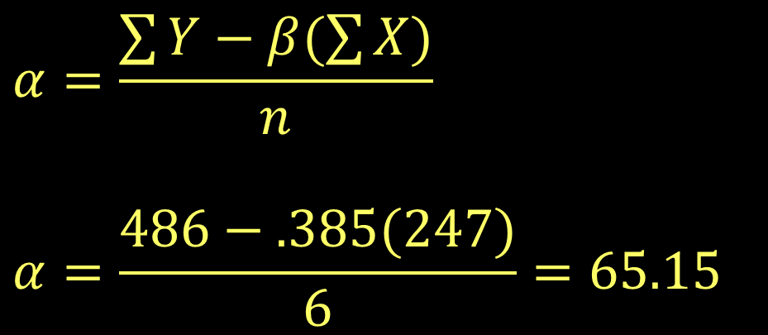
Calculating your regression line
Neighborhood | Median age | Number of gardens | X² | XY
1 | 43 | 99 | 1849 | 4257
2 | 21 | 65 | 441 | 1365
3 | 25 | 79 | 625 | 1975
4 | 42 | 75 | 1764 | 3150
5 | 57 | 87 | 3249 | 4959
6 | 59 | 81 | 3481 | 4779
Total | 247 | 486 | 11409 | 20485

Slide 14
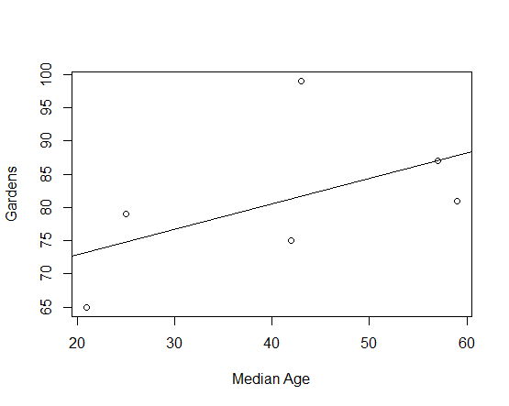
Calculating your regression line
Y= 0.385x + 65.15
Neighborhood | Median age | Number of gardens | X² | XY
1 | 43 | 99 | 1849 | 4257
2 | 21 | 65 | 441 | 1365
3 | 25 | 79 | 625 | 1975
4 | 42 | 75 | 1764 | 3150
5 | 57 | 87 | 3249 | 4959
6 | 59 | 81 | 3481 | 4779
Total | 247 | 486 | 11409 | 20485

Slide 15
Interpreting the coefficient
W
Y= 0.385x + 65.15
Each year of increase in median age in the neighborhood is associated with 0.385 more gardens.
What does this mean? Focus on three things:
Magnitude: How big is the coefficient?
Direction: Positive or negative?
Significance: Is p < 0.05?

Slide 16
Interpreting the coefficient
W
Y= 0.385x + 65.15
Interpreting magnitude can be tricky!
What’s the difference in age between neighborhoods 2 and 5?
What’s the predicted difference in gardens based on our model?
Neighborhood | Median age | Number of gardens | X² | XY
1 | 43 | 99 | 1849 | 4257
2 | 21 | 65 | 441 | 1365
3 | 25 | 79 | 625 | 1975
4 | 42 | 75 | 1764 | 3150
5 | 57 | 87 | 3249 | 4959
6 | 59 | 81 | 3481 | 4779
Total | 247 | 486 | 11409 | 20485

Slide 17
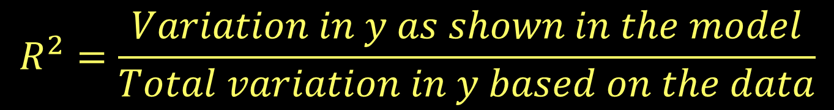
How good is the model fit?
R² is the proportion of variance in the data explained by your model, the “coefficient of determination.”
We won’t go over how it’s calculated, but the rough version is this (see p. 256-258 for more info):

Slide 18
Y= 0.385x + 65.15
This model has an R² of .2807.
That means it explains about 28% of the total variation in gardens between neighborhoods
(That’s not very good.)
Neighborhood | Median age | Number of gardens | X² | XY
1 | 43 | 99 | 1849 | 4257
2 | 21 | 65 | 441 | 1365
3 | 25 | 79 | 625 | 1975
4 | 42 | 75 | 1764 | 3150
5 | 57 | 87 | 3249 | 4959
6 | 59 | 81 | 3481 | 4779
Total | 247 | 486 | 11409 | 20485

Slide 19
Model fit is also calculated through ANOVA
Neighborhood | Median age | Number of gardens | Predicted gardens | Difference
1 | 43 | 99 | 81.7 | 17.3
2 | 21 | 65 | 73.2 | -8.2
3 | 25 | 79 | 74.8 | 4.2
4 | 42 | 75 | 81.3 | -6.3
5 | 57 | 87 | 87.1 | -.1
6 | 59 | 81 | 87.1 | -6.9
Total | 247 | 486
Is the model based on these variables a better predictor of the dependent variable than an “intercept only” model with just the constant?

Slide 20
Model fit is also calculated through ANOVA
Neighborhood | Median age | Number of gardens | Predicted gardens | Difference
1 | 43 | 99 | 81.7 | 17.3
2 | 21 | 65 | 73.2 | -8.2
3 | 25 | 79 | 74.8 | 4.2
4 | 42 | 75 | 81.3 | -6.3
5 | 57 | 87 | 87.1 | -.1
6 | 59 | 81 | 87.1 | -6.9
Total | 247 | 486
What’s the variance of these two groups relative to the mean of y (81)?
This is calculated by squaring and summing two things: 1) Diff. of predicted values and the mean (variance between groups)
2) Diff. of predicted values and actual values (variance within groups)

Slide 21
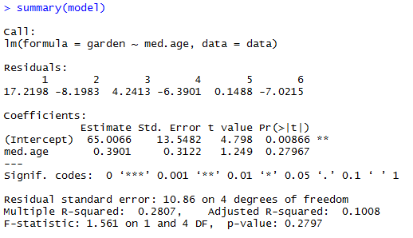
Regression in R

Slide 22
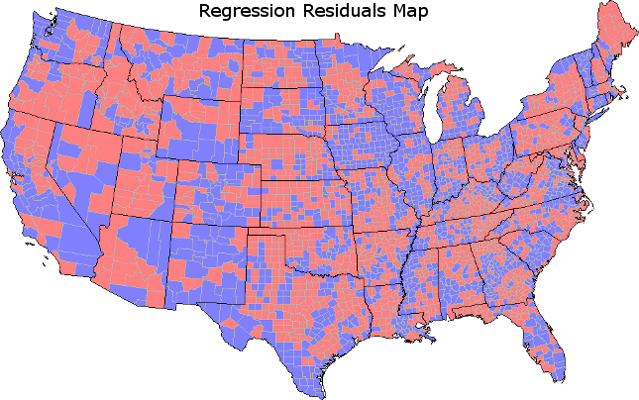
Model Diagnostics
Examine normality of model residuals
Examine the spatial distribution of residuals

Slide 23
Residuals matter!
Neighborhood | Median age | Number of gardens | Predicted gardens | Difference
1 | 43 | 99 | 81.7 | 17.3
2 | 21 | 65 | 73.2 | -8.2
3 | 25 | 79 | 74.8 | 4.2
4 | 42 | 75 | 81.3 | -6.3
5 | 57 | 87 | 87.1 | -.1
6 | 59 | 81 | 87.1 | -6.9
Total | 247 | 486
Where are residuals especially high?
What might account for that difference?

Slide 24
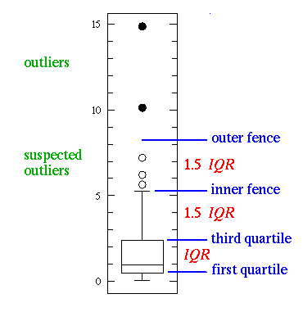
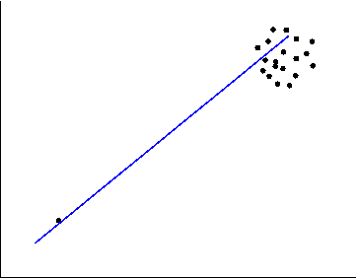
Model Diagnostics
Examine normality of model residuals
Examine the spatial distribution of residuals
Assess the impact of outliers

Slide 25
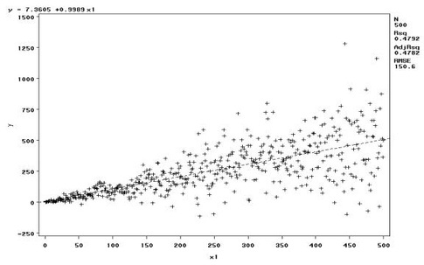
Model Diagnostics
Examine normality of model residuals
Examine the spatial distribution of residuals
Assess the impact of outliers
Look for heteroskedasticity

Slide 26

Oh, no! My model has issues!
Look for possible causes/missing variables
Transform variables (log is most common)
Remove outliers if they appear incorrect or topcode them.
For heteroskedastic models, see https://www3.nd.edu/~rwilliam/stats2/l25.pdf

